Slide 1
COLOR MODELS
By
Ashis Pradhan
(CSE Department, SMIT)

Slide 2
Color Models
Color models provide a standard way to specify a particular color, by defining a 3D coordinate system, and a subspace that contains all constructible colors within a particular model.
Any color that can be specified using a model will correspond to a single point within the subspace it defines.
Each color model is oriented towards either specific hardware (RGB,CMY,YIQ), or image processing applications (HSI).

Slide 3
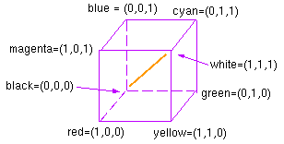
The RGB Color Cube
The additive color model used for computer graphics is represented by the RGB color cube, where R, G, and B represent the colors produced by red, green and blue phosphorus, respectively.

Slide 4
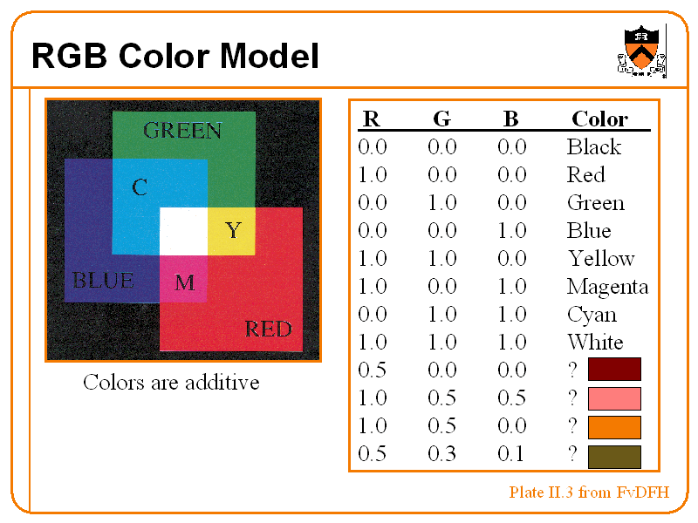

Slide 5
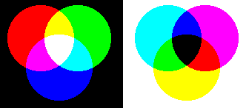
The RGB Model
This is an additive model, i.e. the colors present in the light add to form new colors, and is appropriate for the mixing of colored light .
The image on the left of figure shows the additive mixing of red, green and blue primaries to form the three secondary colors yellow (red + green), cyan (blue + green) and magenta (red + blue), and white ((red + green + blue).
The figure on the right shows the three subtractive primaries, and their pairwise combinations to form red, green and blue, and finally black by subtracting all three primaries from white.
The RGB model is used for color monitors and most video cameras.

Slide 6
The RGB Model
This is an additive model, i.e. the colors present in the light add to form new colors, and is appropriate for the mixing of colored light for example. The image on the left of figure shows the additive mixing of red, green and blue primaries to form the three secondary colors yellow (red + green), cyan (blue + green) and magenta (red + blue), and white ((red + green + blue).
The RGB model is used for color monitors and most video cameras.
The figure on the left shows the additive mixing of red, green and blue primaries to form the three secondary colors yellow (red + green), cyan (blue + green) and magenta (red + blue), and white ((red + green + blue). The figure on the right shows the three subtractive primaries, and their pairwise combinations to form red, green and blue, and finally black by subtracting all three primaries from white.

Slide 7
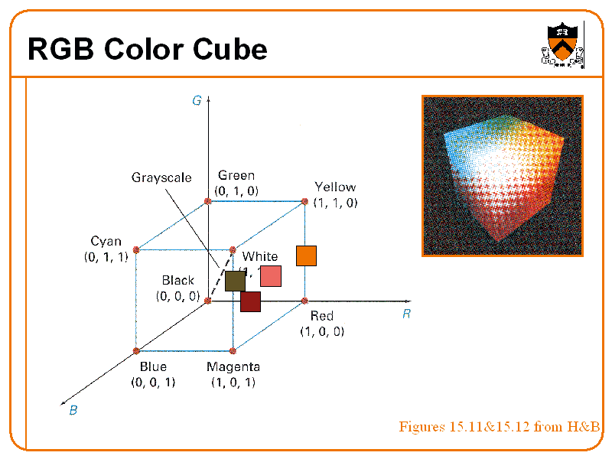

Slide 8
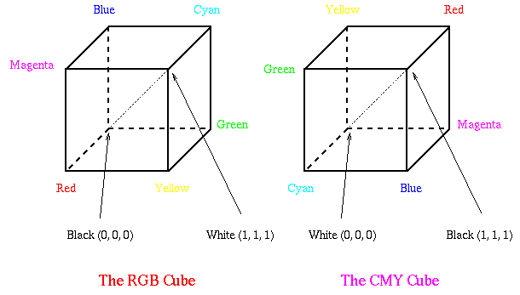
CMY Color Model
  Cyan, Magenta, and Yellow (CMY) are complementary colors of RGB. They can be used as Subtractive Primaries(Color specified by what is subtracted from white light).
CMY model is mostly used in printing devices where the color pigments on the paper absorb certain colors (e.g., no red light reflected from cyan ink).

Slide 9
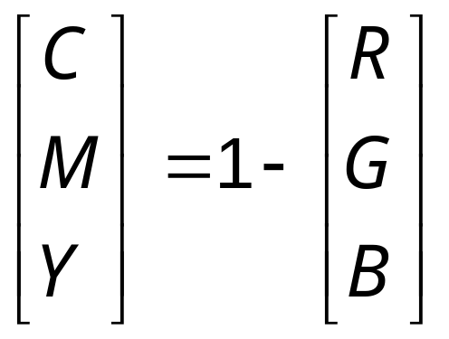
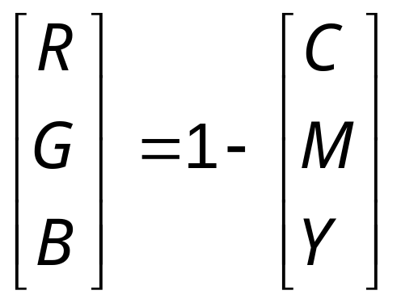
Conversion between RGB and CMY
W = (0, 0, 0) B = (1, 1, 1)
Conversion from RGB to CMY
Conversion from CMY to RGB

Slide 10
Color Printing
Green paper is green because it reflects green and absorbs other wavelengths. The following table summarizes the properties of the four primary types of printing ink.
dye color
absorbs
reflects
cyan
red
blue and green
magenta
green
blue and red
yellow
blue
red and green
black
all
none
To produce blue, one would mix cyan and magenta inks, as they both reflect blue while each absorbing one of green and red. Unfortunately, inks also interact in non-linear ways. This makes the process of converting a given monitor color to an equivalent printer color a challenging problem.
Black ink is used to ensure that a high quality black can always be printed, and is often referred to as to K. Printers thus use a CMYK color model.

Slide 11
YIQ
Color model

Slide 12
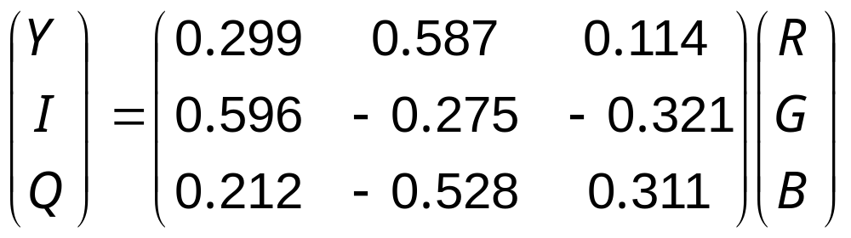
YIQ Color Model
YIQ
  Y: luminance
  I, Q: chromaticity
  Only Y shown in black-and-white TV
RGB → YIQ

Slide 13
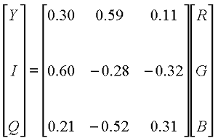
YIQ Color model
The YIQ (luminance-inphase-quadrature) model is a recoding (for transmission efficiency) of RGB for color television, and is a very important model for color image processing. The importance of luminance was discussed .
The conversion from RGB to YIQ is given by:
  Luminance – gives a measure of amount of energy an observer perceives from the light source, measured in lumens (lm).

Slide 14
The luminance (lm) component contains all the information required for black and white television, and captures our perception of the relative brightness of particular colors.
That we perceive green as much lighter than red, and red lighter than blue, is indicated by their respective weights of 0.587, 0.299 and 0.114 in the first row of the conversion matrix above.
These weights should be used when converting a color image to grayscale if you want the perception of brightness to remain the same.

Slide 15
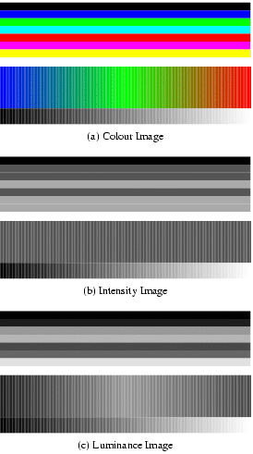
The YIQ Model
Figure: Image (a) shows a color test pattern, consisting of horizontal stripes of black, blue, green, cyan, red, magenta and yellow, a color ramp with constant intensity, maximal saturation, and hue changing linearly from red through green to blue, and a greyscale ramp from black to white. Image (b) shows the intensity for image (a). Note how much detail is lost. Image (c) shows the luminance. This third image accurately reflects the brightness variations perceived in the original image

Slide 16
Intuitive Color Concepts
Terminology
Perceptual Term | Colorimetry | Comments
hue | dominated wavelength | to distinguish colors
saturation | excitation purity | e.g., red and pink
Lightness (reflecting objects) | luminance
Brightness (self-luminous objects) | luminance | e.g., Sun, CRT

Slide 17
Intuitive Color Concepts
tints
white
pure color
tones
  Tint: white pigment added to pure pigment
  ➔ saturation reduced
  Shade: black pigment added to pure pigment
  ➔ lightness reduced
  Tone: consequence of adding both white and black pigments to pure pigments
grays
shades
black

Slide 18
HSV Color Model
HSV = Hue, Saturation, and Value
  A.k.a. HSB, where B is Brightness
RGB, CMY, and YIQ: hardware-oriented
HSV and HLS: user-oriented
Cylinder coordinate system
  Space: hexcone
  hexagon is obtained from the color cube in isometric projection
  (h, s, v), where h ∈ [0, 360) and s, v ∈ [0, 1]
    hue: angle round the hexagon
    saturation: distance from the center
    value: axis through the center

Slide 19
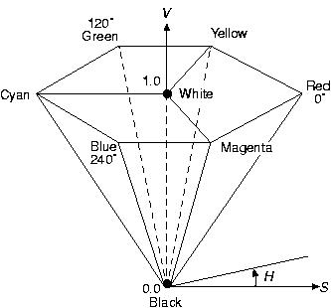
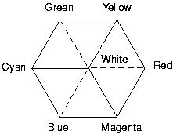
HSV Color Model
Color Cube Hexcone

Slide 20
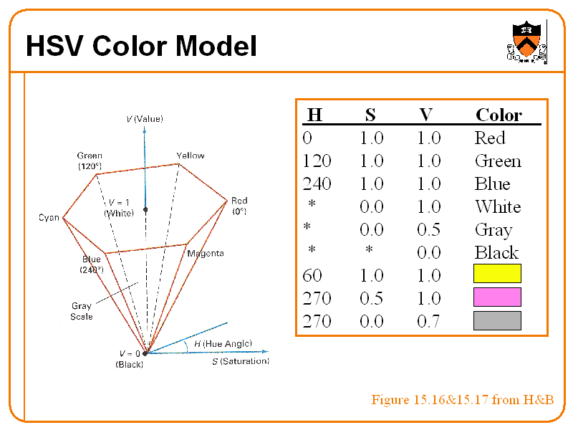

Slide 21
HSV Color Model
W = (-, 0, 1)
B = (-, 0, 0)
R = (0, 1, 1)
Y = (60, 1, 1)
:
M = (300, 1, 1)
Adding white pigments ⇔ S↓
Adding black pigments ⇔ V↓
Creating tones ⇔ S↓ and V↓

Slide 22
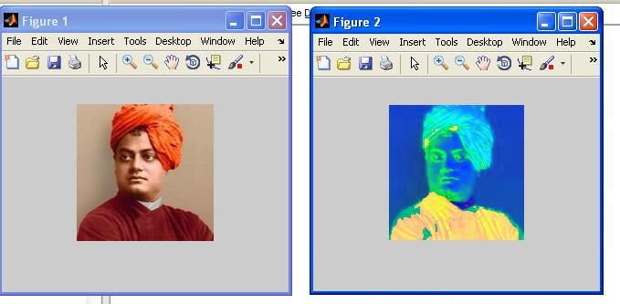
RGB to HSV

Slide 23
HSV Color Model
True color system: 16 million colors
Human eyes can distinguish
  128 hues
  130 tints (saturation levels)
  23 shades of yellow colors, 16 of blue colors
  ➔ 128 x 130 x 23 = 82720 colors

Slide 24
HSI Color Model
  Hue (dominant colour seen)
    Wavelength of the pure colour observed in the signal.
    Distinguishes red, yellow, green, etc.
    More the 400 hues can be seen by the human eye.
  Saturation (degree of dilution)
    Inverse of the quantity of “white” present in the signal. A pure colour has 100% saturation, the white and grey have 0% saturation.
    Distinguishes red from pink, marine blue from royal blue, etc.
    About 20 saturation levels are visible per hue.
  Intensity
    Distinguishes the gray levels.

Slide 25
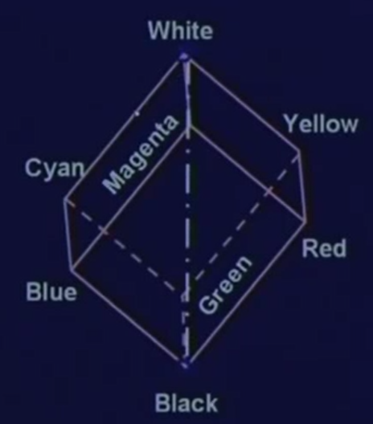
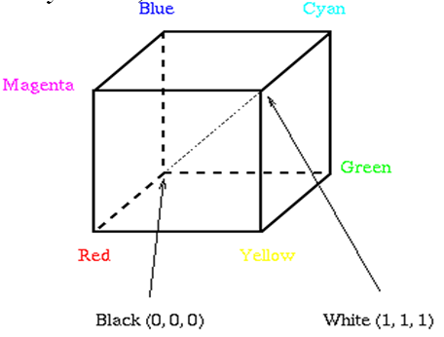
RGB
HSI

Slide 26
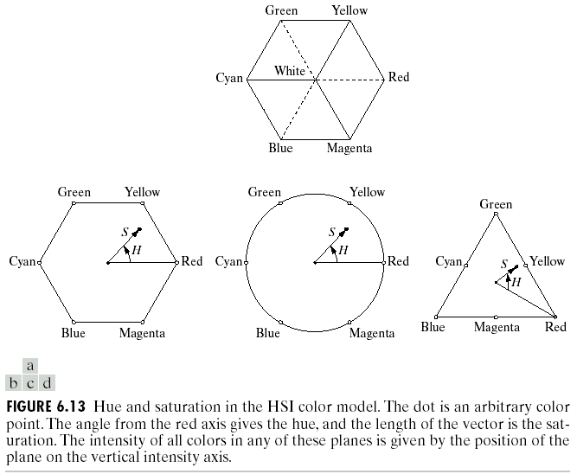

Slide 27



Slide 28
HSI Color Model
Separates out intensity I from the coding
Two values (Hue & Saturation) encode chromaticity
Intensity encode monochrome part.
Hue and saturation of colors respond closely to the way humans perceive color, and thus this model is suited for interactive manipulation of color images .

Slide 29
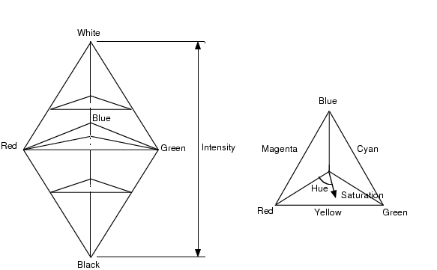
The HSI Model
Figure : The HSI model, showing the HSI solid on the left, and the HSI triangle on the right, formed by taking a horizontal slice through the HSI solid at a particular intensity. Hue is measured from red, and saturation is given by distance from the axis. Colors on the surface of the solid are fully saturated, i.e. pure colors, and the grayscale spectrum is on the axis of the solid. For these colors, hue is undefined.

Slide 30
Properties of HSI (HSV)
Hue H is defined by an angle
Saturation S models the purity of the color
I=(R+G+B)/3

Slide 31

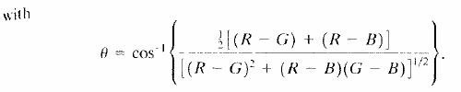
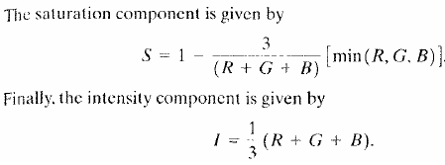
Conversion from RGB to HSI
Given an image in RGB color format, the H component of each RGB pixel is obtained using the equation:

Slide 32
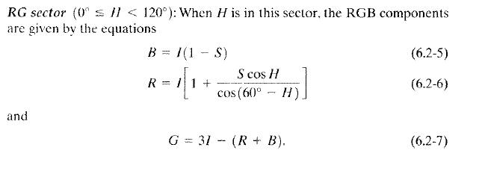
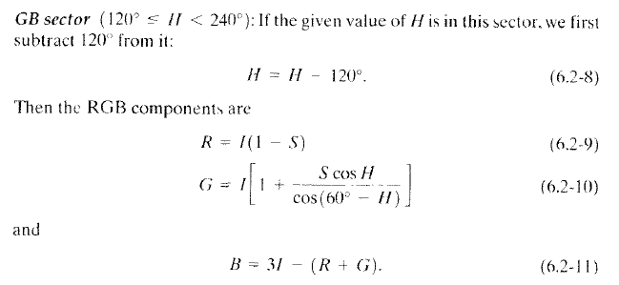
Conversion from HSI to RGB

Slide 33
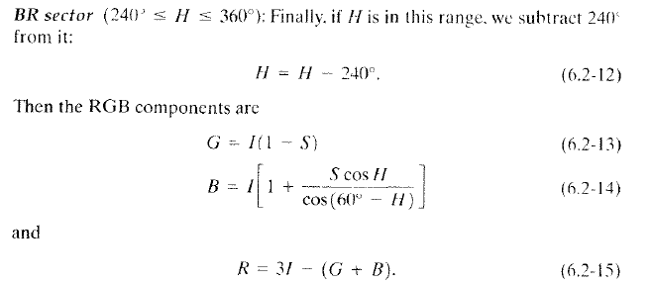
Conversion from HSI to RGB

Slide 34
Conclusions
    color - in computer graphics we use an additive color model
      * colors are represented using Red, Green, and Blue components
      * the CRT has a mechanism for displaying these three components
      * a 24-bit RGB color model uses 8 bits for each of red, green, and blue
      * the human eye processes color similarly - there are three kinds of cones
      * RGB color model combines color and intensity information in each component
      * HSI color model separates intensity from color information
      * java.awt.Color provides a method to do conversion
        * HSICalc.java
        * documentation for RGBtoHSB( ) is online

